Slide 1
Interrupt & Disrupt Implicit Bias, Islamophobia and Microaggressions
Teacher Workshop

Slide 2
Learning Objectives
To examine myths and misconceptions about Islam and Muslims prevalent in media
To define the meaning of Islamophobia and its consequences
To differentiate between interpersonal and structural/systemic forms of Islamophobia
To identify what constitutes a safe learning environment
Workshop adapted from “What Is Islamophobia? Interpersonal vs. Structural Discrimination: Teaching for Change” by Alison Kysia

Slide 3
Safe Space Disclaimer
Recognize your own social position
Be respectful but honest in your discussions
Lend a mindful and critical voice
Don’t make assumptions - don’t be afraid to ask questions if you don’t know

Slide 4
Interrupt & Disrupt Implicit Bias!
What have you learned about Islam and Muslims lately?
What are some myths, misconceptions, or stereotypes that you’ve heard about Muslims?
What are some myths, misconceptions, or stereotypes that you’ve heard about the religion of Islam?

Slide 5
What is Islamophobia?
Activity: Does Islamophobia exist in Canada?
Participants are asked to define Islamophobia without looking it up. Define the two forms of Islamophobia.
Interpersonal or private Islamophobia
Systemic or structural Islamophobia
This exercise should be done in groups of 2-4 and the definitions and examples should be written on a chart paper.
Participants will then review a variety of voices and view different examples and analyses in order to create their very own working definition of Islamophobia. Each group should be given the following handouts below at the start of this activity. Handouts: 1) Spoken Word (Unmet Friends), 2 ) two news articles, 3) “Homeland” cover poster, 4) Interpersonal vs. systemic Islamophobia graphic organizer
Each handout also comes with a set of questions that should be answered by the group.

Slide 6
Islamophobia in Canada
UnMet Friends 2.0
A spoken word poetry by Amal Albaz. Amal’s voice is clear and strong. It captures the negotiations that run through her mind as she lives her life as a proud Muslim.
Various news articles
--What happened in the story?
--How is this incident Islamophobic?
--Who are the victims? How were they affected?
--Who was directly affected by what happened?
Who was indirectly affected by what happened?
Movies and Entertainment
This examines particularly the messaging sent to viewers who watch “Homeland” on Netflix.

Slide 7
Define Islamophobia as a group.
Co-construct a definition of Islamophobia
& discuss the consequences
Interpersonal versus structural/systemic Islamophobia

Slide 8
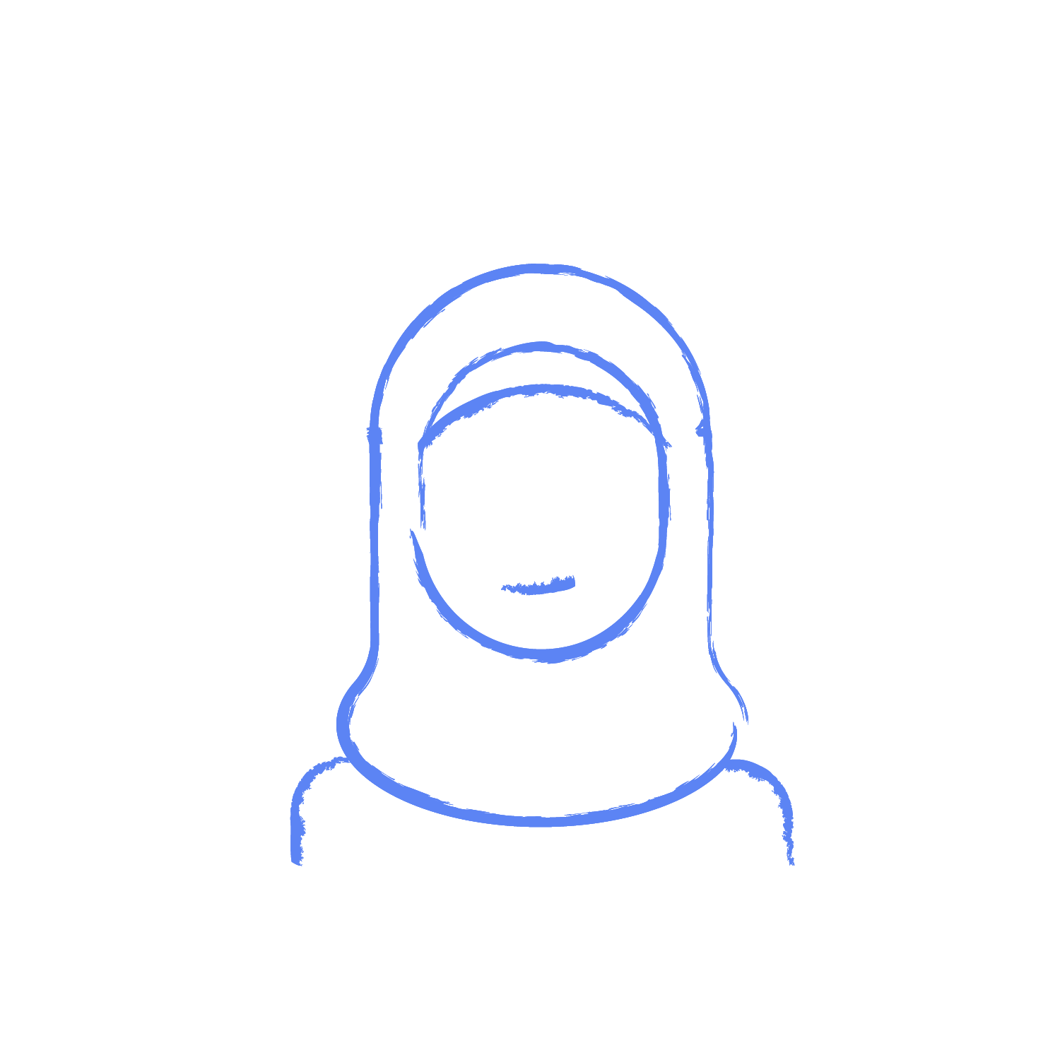
Definition of Islamophobia
Interpersonal islamophobia is directed by an individual(s) onto a Muslim(s), commonly defined as the fear, suspicion and violent targeting of Muslims by private actors. For example the London Ontario attack that wiped out 3 generations of a Muslim family for simply being Muslim and walking on the street.
Structural/systemic islamophobia is the fear and suspicion of Muslims on the part of government institutions, that advance policy, programing and advancements of law to the detriment of Muslims.
*Definitions by Khaled Beydoun in American Islamophobia

Slide 9
Definition of Islamophobia**: Islamophobia, at least partially, refers to a system of advantages and disadvantages based on the othering of Muslims from the dominant culture. At a personal level, prejudice and discrimination represent;
a) the belief that members of different religio-cultural groupings have different characteristics that are understood hierarchically or placed along a binary of inferior/superior;
b) the conditioning and stereotypes internalized and replicated by members of the dominant culture/grouping and
c) actions taken related to these beliefs and conditioning which include the systemic misuse of power by individuals and institutions.
**Definition taken from MAC’s Anti-Islamophobia course offered online.

Slide 10
Consequences of Islamophobia?
What are some consequences of Islamophobia?
On a personal level: How do you think it feels to be subjected to Islamophobia?
Hurt; emotionally impacted
Afraid; paranoid; threatened; unsafe
Unwelcome; alienated
Ashamed; low self esteem
On a community level: How do you think Muslim communities are affected by Islamophobia?
Higher levels of mental illness; not enough resources to specifically meet the psychological needs of Muslims
Trauma
Distrust in the non-Muslim community, the authorities (law enforcement or government agents), etc.
Houses of worship and homes feel unsafe and under threat

Slide 11
What can you do to create a safe learning environment?
Become an ally to Muslims
Beware of your implicit bias and your social position
See the humanity in others
Take meaningful action

Slide 12
Exit Activity: Make a Commitment
Revisit the stereotypes that you wrote at the beginning of the workshop.
If you feel they have been disproved, cross them out.
On the back of the card, write down one action item you are going to implement - a commitment to stand up to hate, and to fight against Islamophobia
No action is too small - write down what you think you can realistically achieve

Slide 13
Thank you

