Slide 1
Sharing the Muslim Salah (prayer) Experience
High School

Slide 2
Learning Objectives
Understand the importance of prayers (salah) in Islam.
Understand the need for Muslims to have a safe clean space to complete their required salah.
Understand that salah is a requirement offered as a means of reflection, redemption and renewal
Reflect on the actions within the Islamic prayer as an invitation to a personal reflection/meditation session, wherein spirituality and action towards oneself and others is evaluated and harnessed.

Slide 3
Experiential Learning

Slide 4
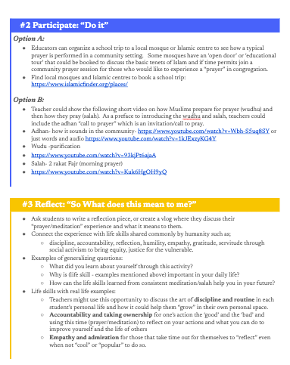
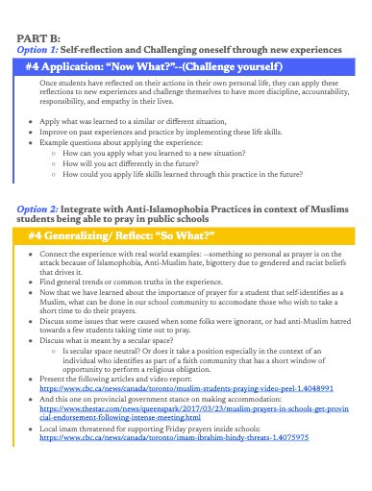

Slide 5
Teacher Preparation
Teachers may review the following resources to build their knowledge base:
What is prayer: https://yaqeeninstitute.ca/abdullah-oduro/pillar-2-what-is-prayer
Why do Muslim pray: https://yaqeeninstitute.ca/abdullah-oduro/pillar-2-why-do-we-pray
Why does God Ask People to Worship Him (infographics) https://yaqeeninstitute.ca/infographics/why-does-god-ask-people-to-worship-him-infographic
Punctuality in prayer: https://yaqeeninstitute.ca/omar-suleiman/allah-loves-punctual-prayer
Islamic Heritage Month: Resource Guidebook for Educators
Find local mosques and Islamic centres https://www.islamicfinder.org/places/

Slide 6
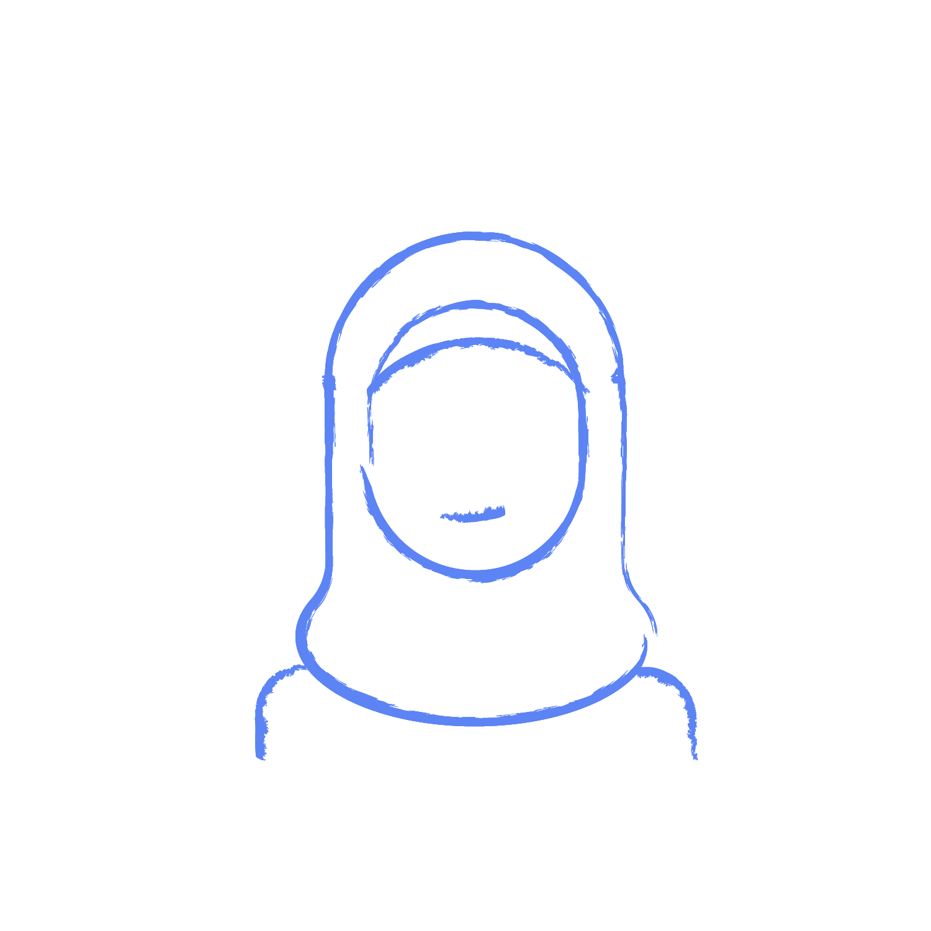
#1: Myths and Misconceptions about Prayer and Islam
Ask students the following questions and ask them to jot their answers down on a cue card given to them:
Who do Muslims pray to?
Why do Muslims pray?
How many prayers do Muslims have in a 24 hour period?
About Prayer:
Muslims worship the moon or a strange god
Muslims supplicate only in Arabic
Muslims who pray all their prayers are fundamentalist
Women are oppressed and/or forced to do things (e.g. pray behind men)
About Islam:
It is a violent, barbaric religion
It oppresses women
It is strict and/or old-fashioned

Slide 7
Facts on Prayer and Islam
Muslims pray 5 times a day. Salah or ‘prayer’ is one of the 5 pillars of Islam.
Prayer is an opportunity for reflection, redemption and renewal.
Men and women are equal in prayer but occupy separate spaces
Muslims can supplicate to Allah in any language
Archangel Gabriel taught the Prophet how to pray how then taught humanity.

Slide 8
#2 Participate: “Do it”
Option B: Video presentation
Teachers could show the following short video on how Muslims prepare for prayer (wudhu) and then how they pray (salah). As a preface to introducing the wudhu and salah, teachers could include the adhan “call to prayer” which is an invitation/call to pray.
Resources:
Adhan- how it actually sounds in a Muslim country https://www.youtube.com/watch?v=Wbh-S5uq8SY
Adhan- Text to adhan and audio https://www.youtube.com/watch?v=1kJExzyKG4Y
Wudhu -purification
https://www.youtube.com/watch?v=93kjPt6ajaA
Salah- 2 rakat Fajr (morning prayer)
https://www.youtube.com/watch?v=Kuk6HgOH9yQ
Option A: A trip in the community
Educators can organize a school trip to a local mosque or an Islamic centre to see how a typical prayer is performed in a community setting.
Resources: Find local mosques and Islamic centres to book a school trip: https://www.islamicfinder.org/places/

Slide 9
#3 Personal Reflection & Life Skills
Option A:
This section invites students to reflect on their previous ‘salah’ experience, either attending ‘salah’ in a community setting (option A) or simply watching the videos capturing the salah experience (option B). Teachers are to facilitate discussion on life skills acquired from consistent action done with conviction.
Teachers might use this opportunity to discuss the art of discipline and routine in each student’s personal life and how it could help them “grow” in their own personal space.
Accountability and taking ownership for one’s action the ‘good’ and the ‘bad’ and using this time (prayer/meditation) to reflect on your actions and what you can do to improve yourself and the life of others
Empathy and admiration for those that take time out for themselves to “reflect” even when not “cool” or “popular” to do so.

Slide 10
#3 Personal Reflection & Life Skills- continued
Sample questions to ask for options A & B:
What did you learn about yourself through this activity?
Why is this particular life skill (ex. discipline) important in your daily life?
How can the life skills learned from consistent meditation/salah help you in your future?

Slide 11
#4 Apply: Challenge yourself to create space!
Option A: Self-Reflection
Once students have reflected on their action in their own personal lives they can apply these reflection to new experiences and challenge themselves to truly benefit from their observations and reflections.
Discuss how more effective behaviors can develop from the new learnings.
Improve on past experiences and practices by implementing these new life skills.
Sample questions about applying the experience:
How can you apply what you learned to a new situation?
How will you act differently in the future?
How could you apply life skills learned through this practice in the future?

Slide 12
#4 Apply:Anti-Islamophobia practices
Options A & B:
Now that we have learned about the importance of prayer for a Muslim student, what can be done in our school community to accomodate those who wish to take a short time to do their prayers?
Discuss some issues that were caused when some folks were ignorant, or had anti-Muslim hatred towards a few students taking time out to pray. Something so personal as prayer is on the attack because of Islamophobia, anti-Muslim hate, bigottery due to gendered and racist beliefs that drives them.
Examine the following news article with a lens to find solutions to issues raised using an anti-islamophobia angle.
Misinformation and Islamophobia on prayer space: https://www.cbc.ca/news/canada/toronto/muslim-students-praying-video-peel-1.4048991
Local imam threatened for supporting Friday prayers inside schools: https://www.cbc.ca/news/canada/toronto/imam-ibrahim-hindy-threats-1.4075975
Discuss what is meant by a secular space?
Is secular space neutral? Or does it take a position especially in the context of an individual who identifies as part of a faith community that has a short window of opportunity to perform a religious obligation.

Slide 13
Assessment:
Reflect on strengths and weaknesses of the lesson as taught.
Describe individual student responses to techniques used. How did they react?
Discuss student "thinking" and ideas.
Ask students for a brief evaluation of the activity. Include their responses.

Slide 14
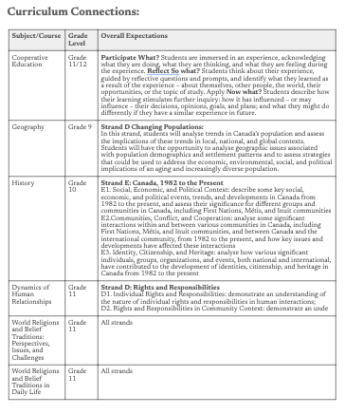
Curriculum Connections

Slide 15
Thank you

